Slide 1
Sqlite3 tutorial
https://www.sqlite.org/
The tutorial example is from
http://www.tutorialspoint.com/sqlite/sqlite_c_cpp.htm

Slide 2
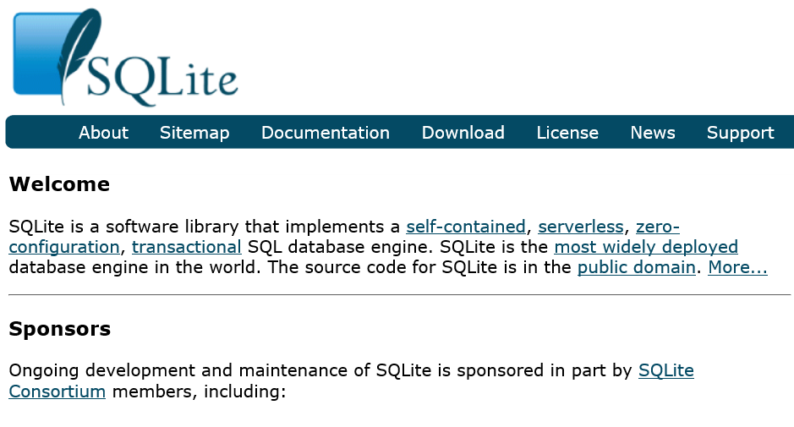
Sqlite3 tutorial and sample programs http://www.tutorialspoint.com/sqlite/sqlite_c_cpp.htm

Slide 3
Sqlite3 tutorial http://www.tutorialspoint.com/sqlite/sqlite_c_cpp.htm
To run the sample codes from the tutorial, you need to do first:
Download sqlite3 (which is included here for linux or cs1.utdallas.edu).
** If you use Mac, you need to download the Mac version of sqlite3.
Create a test database test.db (by Unix/Linux command: touch test.db)
Read the tutorials and try these programs from test0.c to test5.c
To compile the sample program (e.g., test0.c), for example, with c++ or g++
g++ test0.c –o test0 –l sqlite3
To have programs (test0.c to test5.c) and
sqlite3 files from www.sqlite.org: sqlite3 and shell.c

Slide 4
Sqlite3 – sample programs http://www.tutorialspoint.com/sqlite/sqlite_c_cpp.htm
test0.c – to connect & open sqlite3 database, and to close.
test1.c – to create a table
test2.c – to insert records
test3.c – to select records and print
test4.c – to update a record
test5.c – to delete a record
The name of the database file used here is: test.db
You may create the file by touch command: touch test.db
If you need to start all over again, delete test.db and then create it.

Slide 5
test0.c – to open and close DB http://www.tutorialspoint.com/sqlite/sqlite_c_cpp.htm
// g++ test0.c -l sqlite3
#include <stdio.h>
#include <sqlite3.h>
int main(int argc, char* argv[])
{ sqlite3 *db;
char *zErrMsg = 0;
int rc;
rc = sqlite3_open(“test.db", &db); // you may create test.db with touch
if( rc ){ fprintf(stderr, "Can't open database: %s\n", sqlite3_errmsg(db));
}else{ fprintf(stderr, "Opened database successfully\n");
}
sqlite3_close(db);
}

Slide 6
test1.c – to create a table http://www.tutorialspoint.com/sqlite/sqlite_c_cpp.htm
#include <stdio.h>
#include <stdlib.h>
#include <sqlite3.h>
static int callback(void *NotUsed, int argc, char **argv, char **azColName){
int i;
for(i=0; i<argc; i++){
printf("%s = %s\n", azColName[i], argv[i] ? argv[i] : "NULL");
}
printf("\n");
return 0;
}

Slide 7
test1.c – to create a table http://www.tutorialspoint.com/sqlite/sqlite_c_cpp.htm
int main(int argc, char* argv[])
{
sqlite3 *db;
char *zErrMsg = 0;
int rc;
char *sql;
/* Open database */
rc = sqlite3_open("test.db", &db);
if( rc ){ fprintf(stderr, "Can't open database: %s\n", sqlite3_errmsg(db));
exit(0);
}else{ fprintf(stdout, "Opened database successfully\n");
}

Slide 8
test1.c – to create a table http://www.tutorialspoint.com/sqlite/sqlite_c_cpp.htm
/* Create SQL statement */
sql = "CREATE TABLE COMPANY(" \
"ID INT PRIMARY KEY NOT NULL," \
"NAME TEXT NOT NULL," \
"AGE INT NOT NULL," \
"ADDRESS CHAR(50)," \
"SALARY REAL );" ;

Slide 9
test1.c – to create a table http://www.tutorialspoint.com/sqlite/sqlite_c_cpp.htm
/* Execute SQL statement */
rc = sqlite3_exec(db, sql, callback, 0, &zErrMsg);
if( rc != SQLITE_OK ){ // not OK
fprintf(stderr, "SQL error: %s\n", zErrMsg);
sqlite3_free(zErrMsg);
}else{
fprintf(stdout, "Table created successfully\n");
}
sqlite3_close(db);
return 0;
}

Slide 10
test2.c – insert records http://www.tutorialspoint.com/sqlite/sqlite_c_cpp.htm
#include <stdio.h>
#include <stdlib.h>
#include <sqlite3.h>
static int callback(void *NotUsed, int argc, char **argv, char **azColName){
int i;
for(i=0; i<argc; i++){
printf("%s = %s\n", azColName[i], argv[i] ? argv[i] : "NULL");
}
printf("\n");
return 0;
}

Slide 11
test2.c – insert records http://www.tutorialspoint.com/sqlite/sqlite_c_cpp.htm
int main(int argc, char* argv[])
{
sqlite3 *db;
char *zErrMsg = 0;
int rc;
char *sql;
/* Open database */
rc = sqlite3_open("test.db", &db);
if( rc ){ fprintf(stderr, "Can't open database: %s\n", sqlite3_errmsg(db));
exit(0);
}else{ fprintf(stderr, "Opened database successfully\n");
}

Slide 12
test2.c – insert records http://www.tutorialspoint.com/sqlite/sqlite_c_cpp.htm
/* Create SQL statement */
sql = "INSERT INTO COMPANY (ID,NAME,AGE,ADDRESS,SALARY) " \
"VALUES (1, 'Paul', 32, 'California', 20000.00 ); " \
"INSERT INTO COMPANY (ID,NAME,AGE,ADDRESS,SALARY) " \
"VALUES (2, 'Allen', 25, 'Texas', 15000.00 ); " \
"INSERT INTO COMPANY (ID,NAME,AGE,ADDRESS,SALARY)" \
"VALUES (3, 'Teddy', 23, 'Norway', 20000.00 );" \
"INSERT INTO COMPANY (ID,NAME,AGE,ADDRESS,SALARY)" \
"VALUES (4, 'Mark', 25, 'Rich-Mond ', 65000.00 );";

Slide 13
test2.c – insert records http://www.tutorialspoint.com/sqlite/sqlite_c_cpp.htm
/* Execute SQL statement */
rc = sqlite3_exec(db, sql, callback, 0, &zErrMsg);
if( rc != SQLITE_OK ){
fprintf(stderr, "SQL error: %s\n", zErrMsg);
sqlite3_free(zErrMsg);
}else{
fprintf(stdout, "Records created successfully\n");
}
sqlite3_close(db);
return 0;
}

Slide 14
test3.c – select records & print http://www.tutorialspoint.com/sqlite/sqlite_c_cpp.htm
#include <stdio.h>
#include <stdlib.h>
#include <sqlite3.h>
static int callback(void *NotUsed, int argc, char **argv, char **azColName){
int i;
for(i=0; i<argc; i++){
printf("%s = %s\n", azColName[i], argv[i] ? argv[i] : "NULL");
}
printf("\n");
return 0;
}

Slide 15
test3.c – select records & print http://www.tutorialspoint.com/sqlite/sqlite_c_cpp.htm
int main(int argc, char* argv[])
{
sqlite3 *db;
char *zErrMsg = 0;
int rc;
char *sql;
/* Open database */
rc = sqlite3_open("test.db", &db);
if( rc ){ fprintf(stderr, "Can't open database: %s\n", sqlite3_errmsg(db));
exit(0);
}else{ fprintf(stderr, "Opened database successfully\n");
}

Slide 16
test3.c – select records & print http://www.tutorialspoint.com/sqlite/sqlite_c_cpp.htm
/* Create SQL statement */
sql = "SELECT * from COMPANY";
/* Execute SQL statement */
rc = sqlite3_exec(db, sql, callback, (void*)data, &zErrMsg);
if( rc != SQLITE_OK ){ fprintf(stderr, "SQL error: %s\n", zErrMsg);
sqlite3_free(zErrMsg);
}else{ fprintf(stdout, "Operation done successfully\n");
}
sqlite3_close(db);
return 0;
}

Slide 17
test4.c – update a record http://www.tutorialspoint.com/sqlite/sqlite_c_cpp.htm
#include <stdio.h>
#include <stdlib.h>
#include <sqlite3.h>
static int callback(void *NotUsed, int argc, char **argv, char **azColName){
int i;
for(i=0; i<argc; i++){
printf("%s = %s\n", azColName[i], argv[i] ? argv[i] : "NULL");
}
printf("\n");
return 0;
}

Slide 18
test4.c – update a record http://www.tutorialspoint.com/sqlite/sqlite_c_cpp.htm
int main(int argc, char* argv[])
{
sqlite3 *db;
char *zErrMsg = 0;
int rc;
char *sql;
/* Open database */
rc = sqlite3_open("test.db", &db);
if( rc ){ fprintf(stderr, "Can't open database: %s\n", sqlite3_errmsg(db));
exit(0);
}else{ fprintf(stderr, "Opened database successfully\n");
}

Slide 19
test4.c – update a record http://www.tutorialspoint.com/sqlite/sqlite_c_cpp.htm
/* Create merged SQL statement */
sql = "UPDATE COMPANY set SALARY = 25000.00 where ID=1; " \
"SELECT * from COMPANY";
/* Execute SQL statement */
rc = sqlite3_exec(db, sql, callback, (void*)data, &zErrMsg);
if( rc != SQLITE_OK ){ fprintf(stderr, "SQL error: %s\n", zErrMsg);
sqlite3_free(zErrMsg);
}else{ fprintf(stdout, "Operation done successfully\n");
}
sqlite3_close(db);
return 0;
}

Slide 20
test5.c – delete a record http://www.tutorialspoint.com/sqlite/sqlite_c_cpp.htm
#include <stdio.h>
#include <stdlib.h>
#include <sqlite3.h>
static int callback(void *NotUsed, int argc, char **argv, char **azColName){
int i;
for(i=0; i<argc; i++){
printf("%s = %s\n", azColName[i], argv[i] ? argv[i] : "NULL");
}
printf("\n");
return 0;
}

Slide 21
test5.c – delete a record http://www.tutorialspoint.com/sqlite/sqlite_c_cpp.htm
int main(int argc, char* argv[])
{
sqlite3 *db;
char *zErrMsg = 0;
int rc;
char *sql;
/* Open database */
rc = sqlite3_open("test.db", &db);
if( rc ){ fprintf(stderr, "Can't open database: %s\n", sqlite3_errmsg(db));
exit(0);
}else{ fprintf(stderr, "Opened database successfully\n");
}

Slide 22
test5.c – delete a record http://www.tutorialspoint.com/sqlite/sqlite_c_cpp.htm
/* Create merged SQL statement */
sql = "DELETE from COMPANY where ID=2; SELECT * from COMPANY";
/* Execute SQL statement */
rc = sqlite3_exec(db, sql, callback, (void*)data, &zErrMsg);
if( rc != SQLITE_OK ){ fprintf(stderr, "SQL error: %s\n", zErrMsg);
sqlite3_free(zErrMsg);
}else{ fprintf(stdout, "Operation done successfully\n");
}
sqlite3_close(db);
return 0;
}

Slide 23
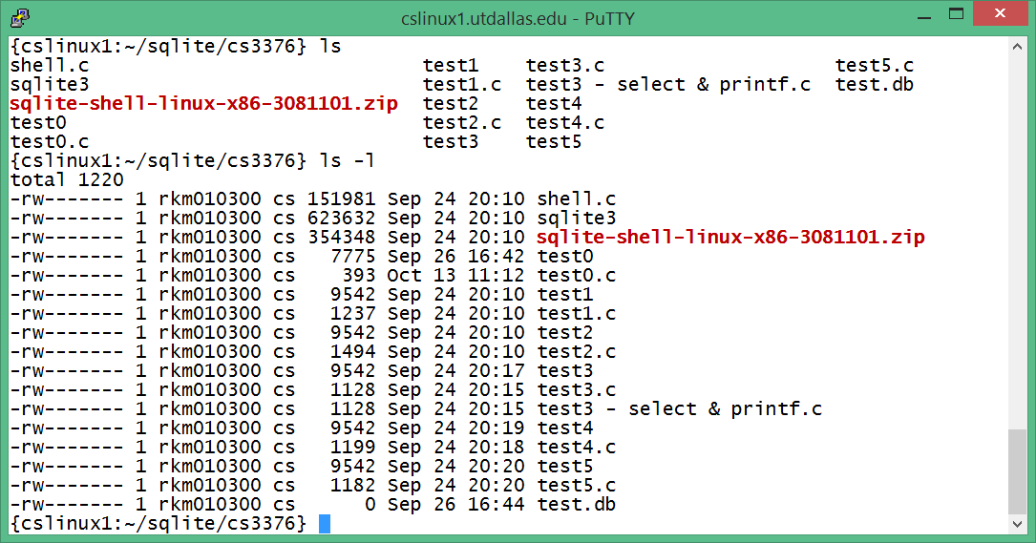
Download sqlite3 and sample programs & Try yourself

Slide 24
You may delete test.db and create a new one
rm test.db
rm: remove regular empty file `test.db'? y
touch test.db

Slide 25
Compile the sample programs
{cslinux1:~/sqlite/cs3376} c++ test1.c -o test1 -l sqlite3
test1.c: In function ‘int main(int, char**)’:
test1.c:36: warning: deprecated conversion from string constant to ‘char*’
{cslinux1:~/sqlite/cs3376} g++ test1.c -o test1 -l sqlite3
test1.c: In function ‘int main(int, char**)’:
test1.c:36: warning: deprecated conversion from string constant to ‘char*’
{cslinux1:~/sqlite/cs3376} c++ test2.c -o test2 -l sqlite3
test2.c: In function ‘int main(int, char**)’:
test2.c:38: warning: deprecated conversion from string constant to ‘char*’

Slide 26
test1-5 programs to run
./test0
Opened database successfully
./test1
Opened database successfully
Table created successfully
./test2
Opened database successfully
Records created successfully

Slide 27
test3 – select records and print
./test3
Opened database successfully
Callback function called: ID = 1
NAME = Paul
AGE = 32
ADDRESS = California
SALARY = 20000.0
Callback function called: ID = 2
NAME = Allen
AGE = 25
ADDRESS = Texas
SALARY = 15000.0
Callback function called: ID = 3
NAME = Teddy
AGE = 23
ADDRESS = Norway
SALARY = 20000.0
Callback function called: ID = 4
NAME = Mark
AGE = 25
ADDRESS = Rich-Mond
SALARY = 65000.0
Operation done successfully

Slide 28
test4 – update a record
./test4
Opened database successfully
Callback function called: ID = 1
NAME = Paul
AGE = 32
ADDRESS = California
SALARY = 25000.0
Callback function called: ID = 2
NAME = Allen
AGE = 25
ADDRESS = Texas
SALARY = 15000.0
Callback function called: ID = 3
NAME = Teddy
AGE = 23
ADDRESS = Norway
SALARY = 20000.0
Callback function called: ID = 4
NAME = Mark
AGE = 25
ADDRESS = Rich-Mond
SALARY = 65000.0
Operation done successfully

Slide 29
test5 – delete record #2
./test5
Opened database successfully
Callback function called: ID = 1
NAME = Paul
AGE = 32
ADDRESS = California
SALARY = 25000.0
Callback function called: ID = 3
NAME = Teddy
AGE = 23
ADDRESS = Norway
SALARY = 20000.0
Callback function called: ID = 4
NAME = Mark
AGE = 25
ADDRESS = Rich-Mond
SALARY = 65000.0
Operation done successfully

Slide 30
Sqlite3 shell (from console)
> sqlite3 test.db
SQLite version 3.6.20
Enter ".help" for instructions
Enter SQL statements terminated with a ";"
sqlite> .help
.backup ?DB? FILE Backup DB (default "main") to FILE
.bail ON|OFF Stop after hitting an error. Default OFF
.databases List names and files of attached databases
.dump ?TABLE? ... Dump the database in an SQL text format
If TABLE specified, only dump tables matching

Slide 31
Sqlite3 – a few important commands
sqlite> .help
.databases List names and files of attached databases
.exit Exit this program
.help Show this message
.output FILENAME Send output to FILENAME
.quit Exit this program
.schema ?TABLE? Show the CREATE statements
If TABLE specified, only show tables matching
LIKE pattern TABLE.
.tables ?TABLE? List names of tables
If TABLE specified, only list tables matching
LIKE pattern TABLE.

Slide 32
Sqlite3 examples
sqlite> .schema
CREATE TABLE COMPANY(ID INT PRIMARY KEY NOT NULL,NAME TEXT NOT NULL,AGE INT NOT NULL,ADDRESS CHAR(50),SALARY REAL );
sqlite> .tables
COMPANY
sqlite> select * from company;
1|Paul|32|California|25000.0
3|Teddy|23|Norway|20000.0
4|Mark|25|Rich-Mond |65000.0
sqlite> .exit

